Slide 1



Software and Hardware Co-optimization for
General Large Language Model Inference on CPU
Hyungmin Kim, Jiwoong Park, Sihwa Lee, Geonho Lee, Sungwan Ryu
Hanyang University
2024 IEEE International Conference on Artificial Intelligence Circuits and Systems
Notes:
Hello, My name is Hyungmin Kim from Hanyang University.
Thanks for inviting me in AICAS 2024 Conference and Let me get started the presentation.

Slide 2
Outline
Background
Preliminary Round
Algorithm Optimization
Software Optimization
Final Round
Algorithm Optimization
Software Optimization
Results
Notes:
The Outline is as belows.
Show you some background of the challenge and explain about algorithm and software optimization of preliminary and final round each.
and finally show you the result of our development.

Slide 3






Background
Optimize Qwen-1.8B, 7B Model
Optimization Result are evaluated in 3 main aspects: - Model Accraucy (dataset: PIQA, ARC-C, HellaSwag) - Memory Consumption - Inference Speed (Throughput, Latency)
Target Model
Inference Backend Framework
Notes:
Firstly, We should have to optimize Qwen one-point-eight and seven billion model.
the optimization result are evaluated in 3 main aspects. model accuracy and memory consumption and inference speed.
when we optimize qwen llm, we can use a lot of backend infernece framework to improve inference speed or memory consumption when inference stage.

Slide 4
Preliminary Stage
Notes:
firstly, i explain about our preliminary stage optimization

Slide 5
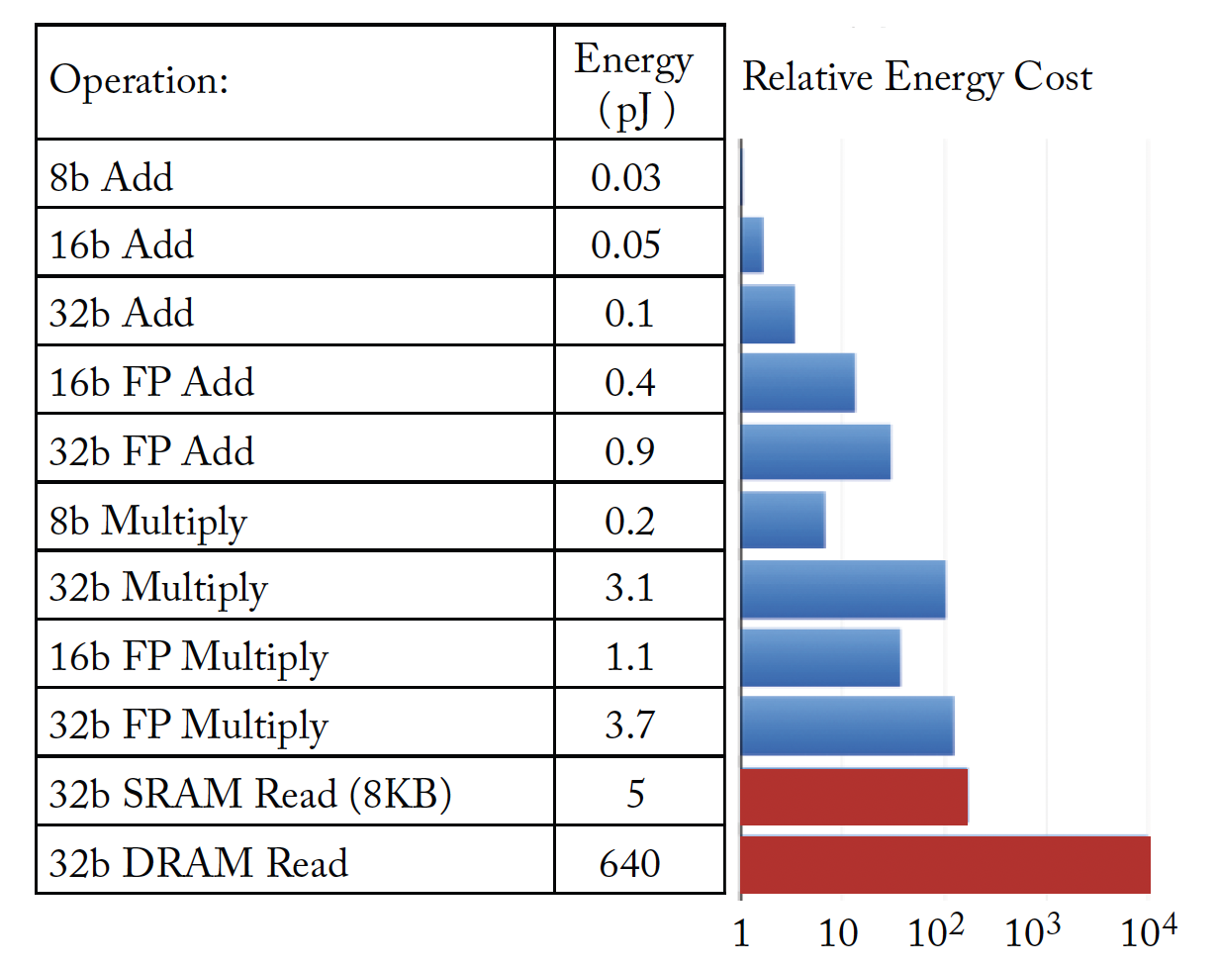
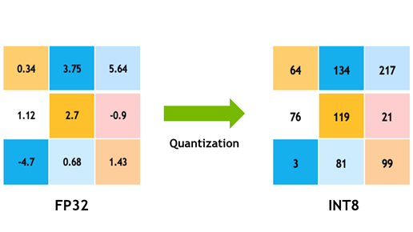
Preliminary Stage – Algorithm Optimization
Optimization Strategy : Quantization
Reduce the bit-precision of model weights and activations to lower computational cost and memory usage.
Challenge: preserve original accuracy with low bit-precision
Notes:
The first strategy we tried was quantization. quantization reduce the bit-precision of model weights and activations to lower computational cost and memory usage.
as you can see in the figure left, low-bit instruction make it more efficient when we use multiply or add operation.
but the challenge is that we should preserve original accracy with low bit-precision

Slide 6
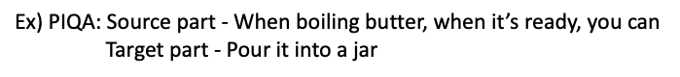


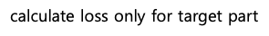
Preliminary Stage – Algorithm Optimization
Fine-tuning - Data Preprocessing (Data Formatting)
Use training dataset of target task (PIQA, ARC-Challenge, HellaSwag)
Directly appended the target to the source part
Notes:
to preserve original model accruacy, we fine tuned for target task.
by using training dataaset of target task, we can train directly the target to the model for specialized task.

Slide 7
Preliminary Stage – Algorithm Optimization
Full fine-tuning Results
Achieved about 5% accuracy improvement compared to the baseline
Fine-Tuning Dataset | Learning rate | Epoch | PIQA | HellaSwag | ARC Challenge | Average accuracy
PIQA + HellaSwag + ARC Challenge | 6E-6 | 1 | 79.60 | 58.03 | 47.01 | 61.54
 | 7E-6 | 1 | 79.54 | 58.10 | 47.78 | 61.80
 | 9E-6 | 1 | 79.87 | 58.08 | 48.63 | 62.19
 | 1E-5 | 1 | 79.98 | 58.06 | 49.06 | 62.36
 | 9E-6 | 3 | 79.54 | 62.16 | 50.6 | 64.10
 | 8E-6 | 3 | 79.76 | 61.94 | 50.51 | 64.07
 | 7E-6 | 3 | 80.03 | 61.09 | 50.00 | 63.70
baseline | 77.15 | 57.44 | 44.11 | 59.57
Notes:
this is full finetuning result. as you can see in this table, the model accuracy achieved about 5% accracy improvement compared to the baseline.

Slide 8
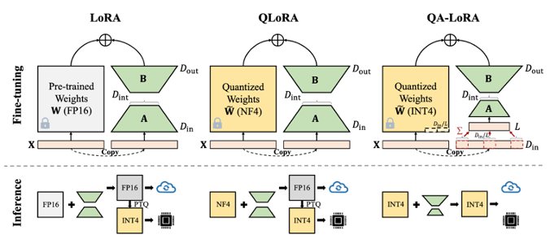

Preliminary Stage – Algorithm Optimization
Goal: Model size↓, but want to maintain accuracy
→ QA-LoRA*: Parameter-efficient Quantization-aware Fine-Tuning
Unlike other methods, it can maintain bit precision even after merging adapters
- * Xu, Yuhui, et al. "Qa-lora: Quantization-aware low-rank adaptation of large language models." arXiv preprint arXiv:2309.14717 (2023).
Notes:
after fine tuning, we apply quantization with qa-lora methodology. which can inference with 4-bit data format unlike other adapter-based method. by using this technique, we can inference qwen llm model with 4-bit data format.
and with lora adapter, we can preserve accracy better than only post training quantization method.

Slide 9
Preliminary Stage – Algorithm Optimization
QA-LoRA Results
Quantization configuration: 4-bit, group size 128, min-max asymmetric
Achieved less than 1% accuracy degradation compared to Fine-tuned FP model
Max VRAM: 21047MB → 7742MB
Method | Learning rate | Epoch | PIQA | HellaSwag | ARC Challenge | Average accuracy
Pre-Trained FP QWEN-7B | - | - | 77.15 | 57.44 | 44.11 | 59.57
Fine-tuned FP QWEN-7B | 9e-6 | 3 | 79.54 | 62.16 | 50.6 | 64.10
Fine-tuned QWEN-7B +PTQ (4bit) | - | - | 78.78 | 57.67 | 45.9 | 60.78
Fine-tuned QWEN-7B + QA-LoRA (4bit) | 9e-6 | 3 | 79.49 | 60.03 | 49.57 | 63.03
Utilize AWQ* Kernel for Quantized Operations.
- * Ji,Jiaming, et al. "AWQ: Activation-aware Weight Quantization for LLM Compression and Acceleration." arXiv preprint arXiv:2306.00978 (2023).
Notes:
this is applying qa-lora result. we used 4-bit and one hundred twenty eight group size configuration. and as you can see in this table, it can preserve better accruacy than a post training quantization method.
and we utilized the AWQ Kernel for 4-bit quantized operation.

Slide 10
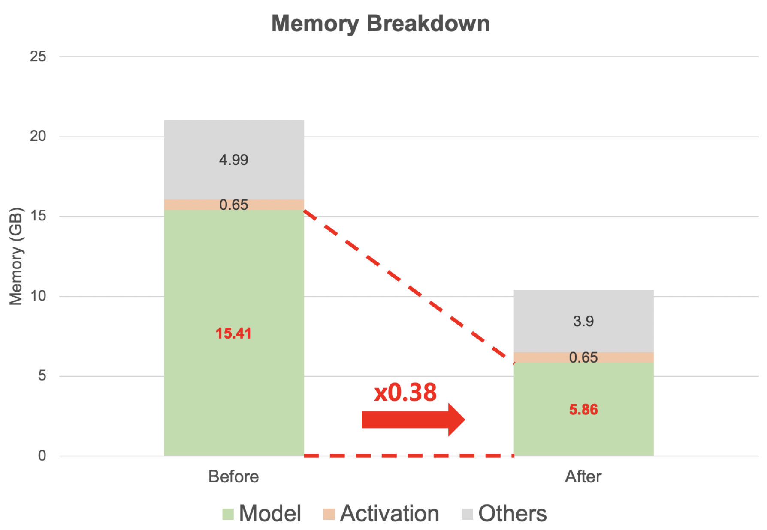
Preliminary Stage
Optimization Results
Latency & Throguhput accelerated by 1.2~1.3x.
Memory Consumption reduced about 2x.
 | Decoding Latency (Tokens/s) | Memory (MB) | Throughtput
Before (PyTorch-FP16) | 3.041 | 21047 | 41.756
After (AWQ-INT4) | 2.296 (x1.24) | 10412 (x0.49) | 55.309 (x1.32)
Notes:
and finally preliminary optimization results. we made one point two to three times faster than original latency and throughput and made a half of memory consumption by applying INT4 quantization.
i think the main contribution of preliminary stage is INT4 quantization. by applying it, we made a half of reduction in memory and littile bit faster than original model.

Slide 11
Semi-Final Stage
Notes:
the next is semi-final stage.

Slide 12
Semi-Final Stage - Algorithm Optimization
Difference with Preliminary stage
Model: Qwen-7B → Qwen-1.8B
Task: PIQA & HellaSwag & ARC-Challenge → PIQA
Full-precision Fine-tuning
Use train dataset of PIQA
Unlike conventional methods, we sweep LR at each epoch → 3% accuracy ↑
Method | Epoch | Initial PIQA | LR | Trained PIQA
LR sweep for each epoch | 1 | 73.12 | 6E-6 | 74.92
 | 2 | 74.92 | 3E-6 | 75.95
 | 3 | 75.95 | 1.9E-7 | 76.06
Single LR sweep | 3 | 73.12 | 9E-6 | 75.68
Notes:
first, algorithmic optimization. in this semi-final stage, the model changes qwen 7 billion to one point eight billion model. and task was also changed.
after all, we first apply full precision finetuning the original model for better accracy of specialized target task.
and with various experimental settings, we made three precent better than original model.

Slide 13

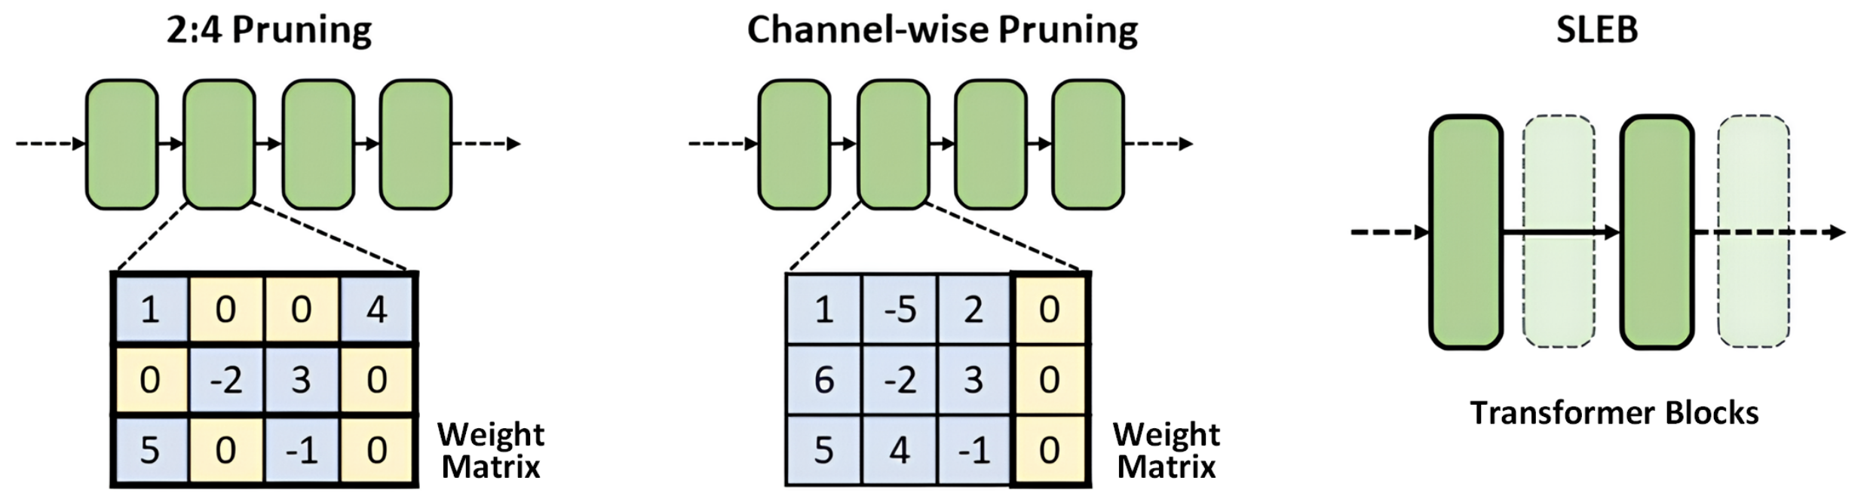
Semi-Final Stage - Algorithm Optimization
Layer Pruning
Unlike other methods, Layer pruning directly reduces the model size and increases throughput
Apply SLEB* Pruning Methodology for Qwen-1.8B Model.
SLEB Pruning Method 1) Evaluate the importance of each transformer block based on the output similarity of the transformer block. 2) Iterate evaluation of pruned model by check prediction results until achieve target pruning rate
Structured Pruning
Layer Pruning
- * Song, Jiwon, et al. "SLEB: Streamlining LLMs through Redundancy Verification and Elimination of Transformer Blocks." arXiv preprint arXiv:2402.09025 (2024).
Notes:
and secondly, we thought that the only quantization is not enough to make a exceptional improvement. so we considered applying layer pruning optimization method.
unlike other methods, layer pruning directly reduces the model size and increase througput without specific kernels or implementation.
and we apply sleb pruning methodology for qwen one point eight model. and i briefly explain about sleb pruning method.
in step1. it evaluate the importance of each transformer block based on output similarity of the transformer block.
and step2. with the target pruning rate, iterate evaluation of pruned model by check prediction results.

Slide 14
Semi-Final Stage - Algorithm Optimization
Layer Pruning
Too many layers can’t be pruned in 1.8B model → Observe accuracy after removing 4, 6, 8 layers
Considering accuracy, model size and throughput, we chose to prune 8 layers
Method | # of deleted layers | # of remaining layers | LR | Epoch | Trained PIQA
- | 0 | 24 | - | - | 75.95
SLEB | 4 | 20 | 1E-5 | 3 | 73.07
 | 6 | 18 | 1E-5 | 3 | 71.87
 | 8 | 16 | 8E-5 | 2 | 71.38
Notes:
due to the model size of qwen one point eight model is small we can't apply pruning so many layers. so we removed four, six, eight layers.
and like i said, with the sleb pruning method, we can get 8 layer pruned model with about seventy-one accuracy model.

Slide 15
Semi-Final Stage - Algorithm Optimization
Quantization-aware Training (QAT) with Knowledge Distillation(KD)
To further reduce memory usage and increase throughput, we implement QAT with KD
Quantization configuration: W: 4-bit, A: 8-bit, GroupSize: 128
KD teacher: Full fine-tuned 24 layers model
There’s no accuracy difference along groupsize → Use groupsize to 128
Baseline | Group size | Accuracy
 |  | PTQ | QAT
71.11 | 32 | 70.98 | 71.22
 | 64 | 70.83 | 71.01
 | 128 | 70.73 | 71.22
Baseline | Group size | Accuracy
 |  | PTQ | QAT | QAT+KD
71.11 | 32 | 70.73 | 71.22 | 71.33
 | 128 | 70.73 | 71.22 | 71.33
- * Kim. et al. "Token-Scaled Logit Distillation for Ternary Weight Generative Language Models." arXiv preprint arXiv:2308.06744v4 (2024).
Notes:
And further improve the efficiency of pruned model, we applied more sophisticated quantization aware training method. which is knowledge distillation. at simple, knowledge distillation compare the output between full precision model and quantized model and calcuate the loss between two output and guide the quantized model to follow full precision model. through this finetuning technique we made 4bit weight model with 8 layer pruned.

Slide 16
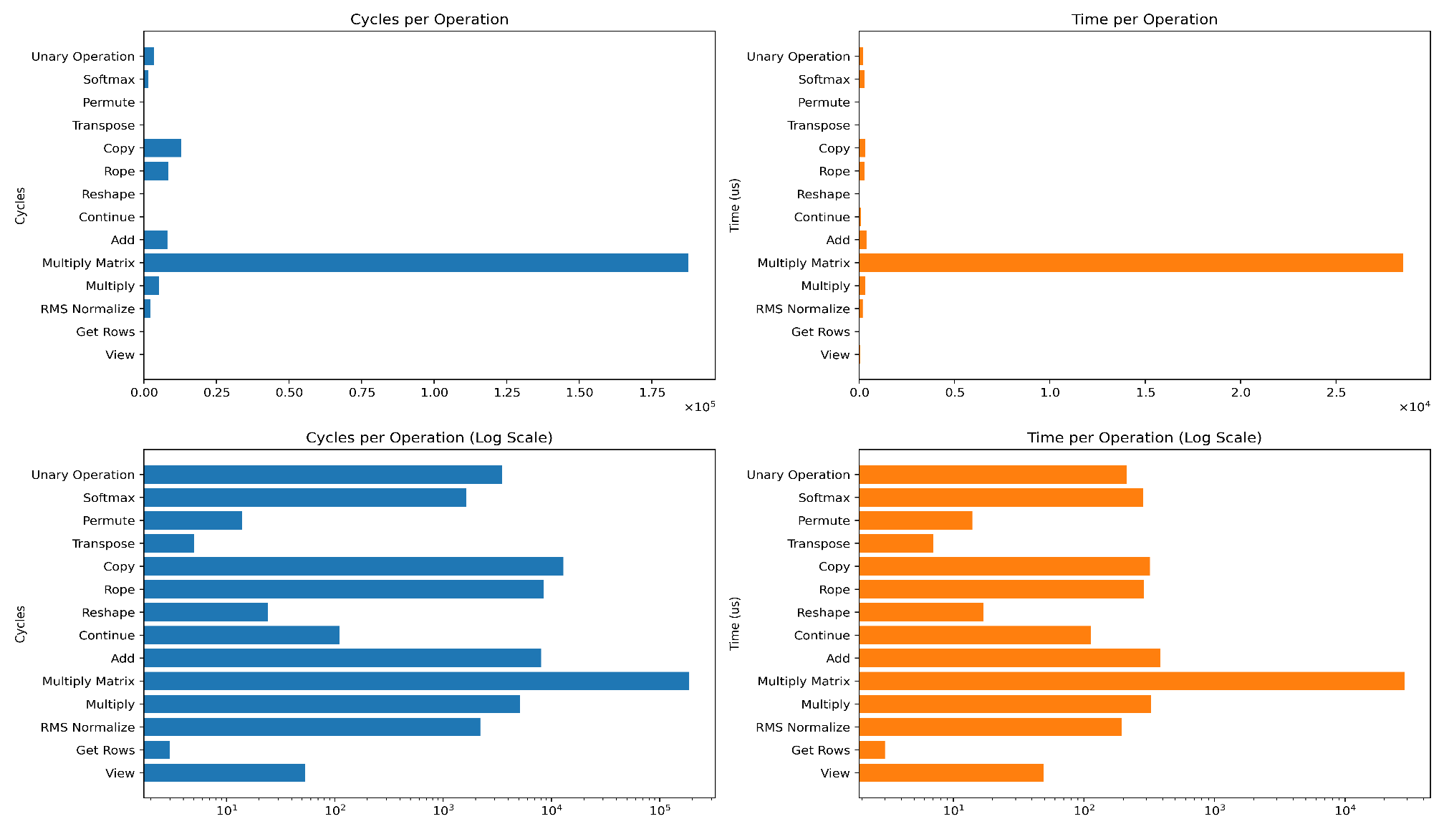
Semi-Final Stage – Software Optimization
Software Optimization
Cycles per Qwen Operation
Times per Qwen Operation
Multiply matrix operation dominants all the execution time.
So, we should optimize multiply matrix operation.
Useful optimization techniques: quantization, layer pruning ...
Notes:
and further we optimize the inference, we should have to utilze it with software optimization.
as you can see in the figure, when we inference the qwen llm model, the multiply matrix operation dominants all the execution time. so, we should optimize multiply matrix operation.
we can reduce this multiply matrix operation time thorugh the quantization and layer pruning and so on.

Slide 17
Semi-Final Stage – Software Optimization
Software Optimization
Llama.cpp: Inference of LLM in Pure C/C++
Sophisticated support for ARM’s SIMD intrinsics
Manage thread-level parallelism, allowing for the concurrent execution of tasks across all 8 cores
Supporting .gguf format which is made of computational graph and easy to extend CPU Kernels.
Notes:
mainly we utilze the llama.cpp which is implemented with pure c and c plus plus. and this library support sophisticated support for arm's simd intrinsics.
and support thread-level parallelism, allowing for the concurrent execution of tasks across all 8 cores.
and supporting gguf format which is made of computational graph and easy to extend cpu kernels. so we decided to use this library.

Slide 18
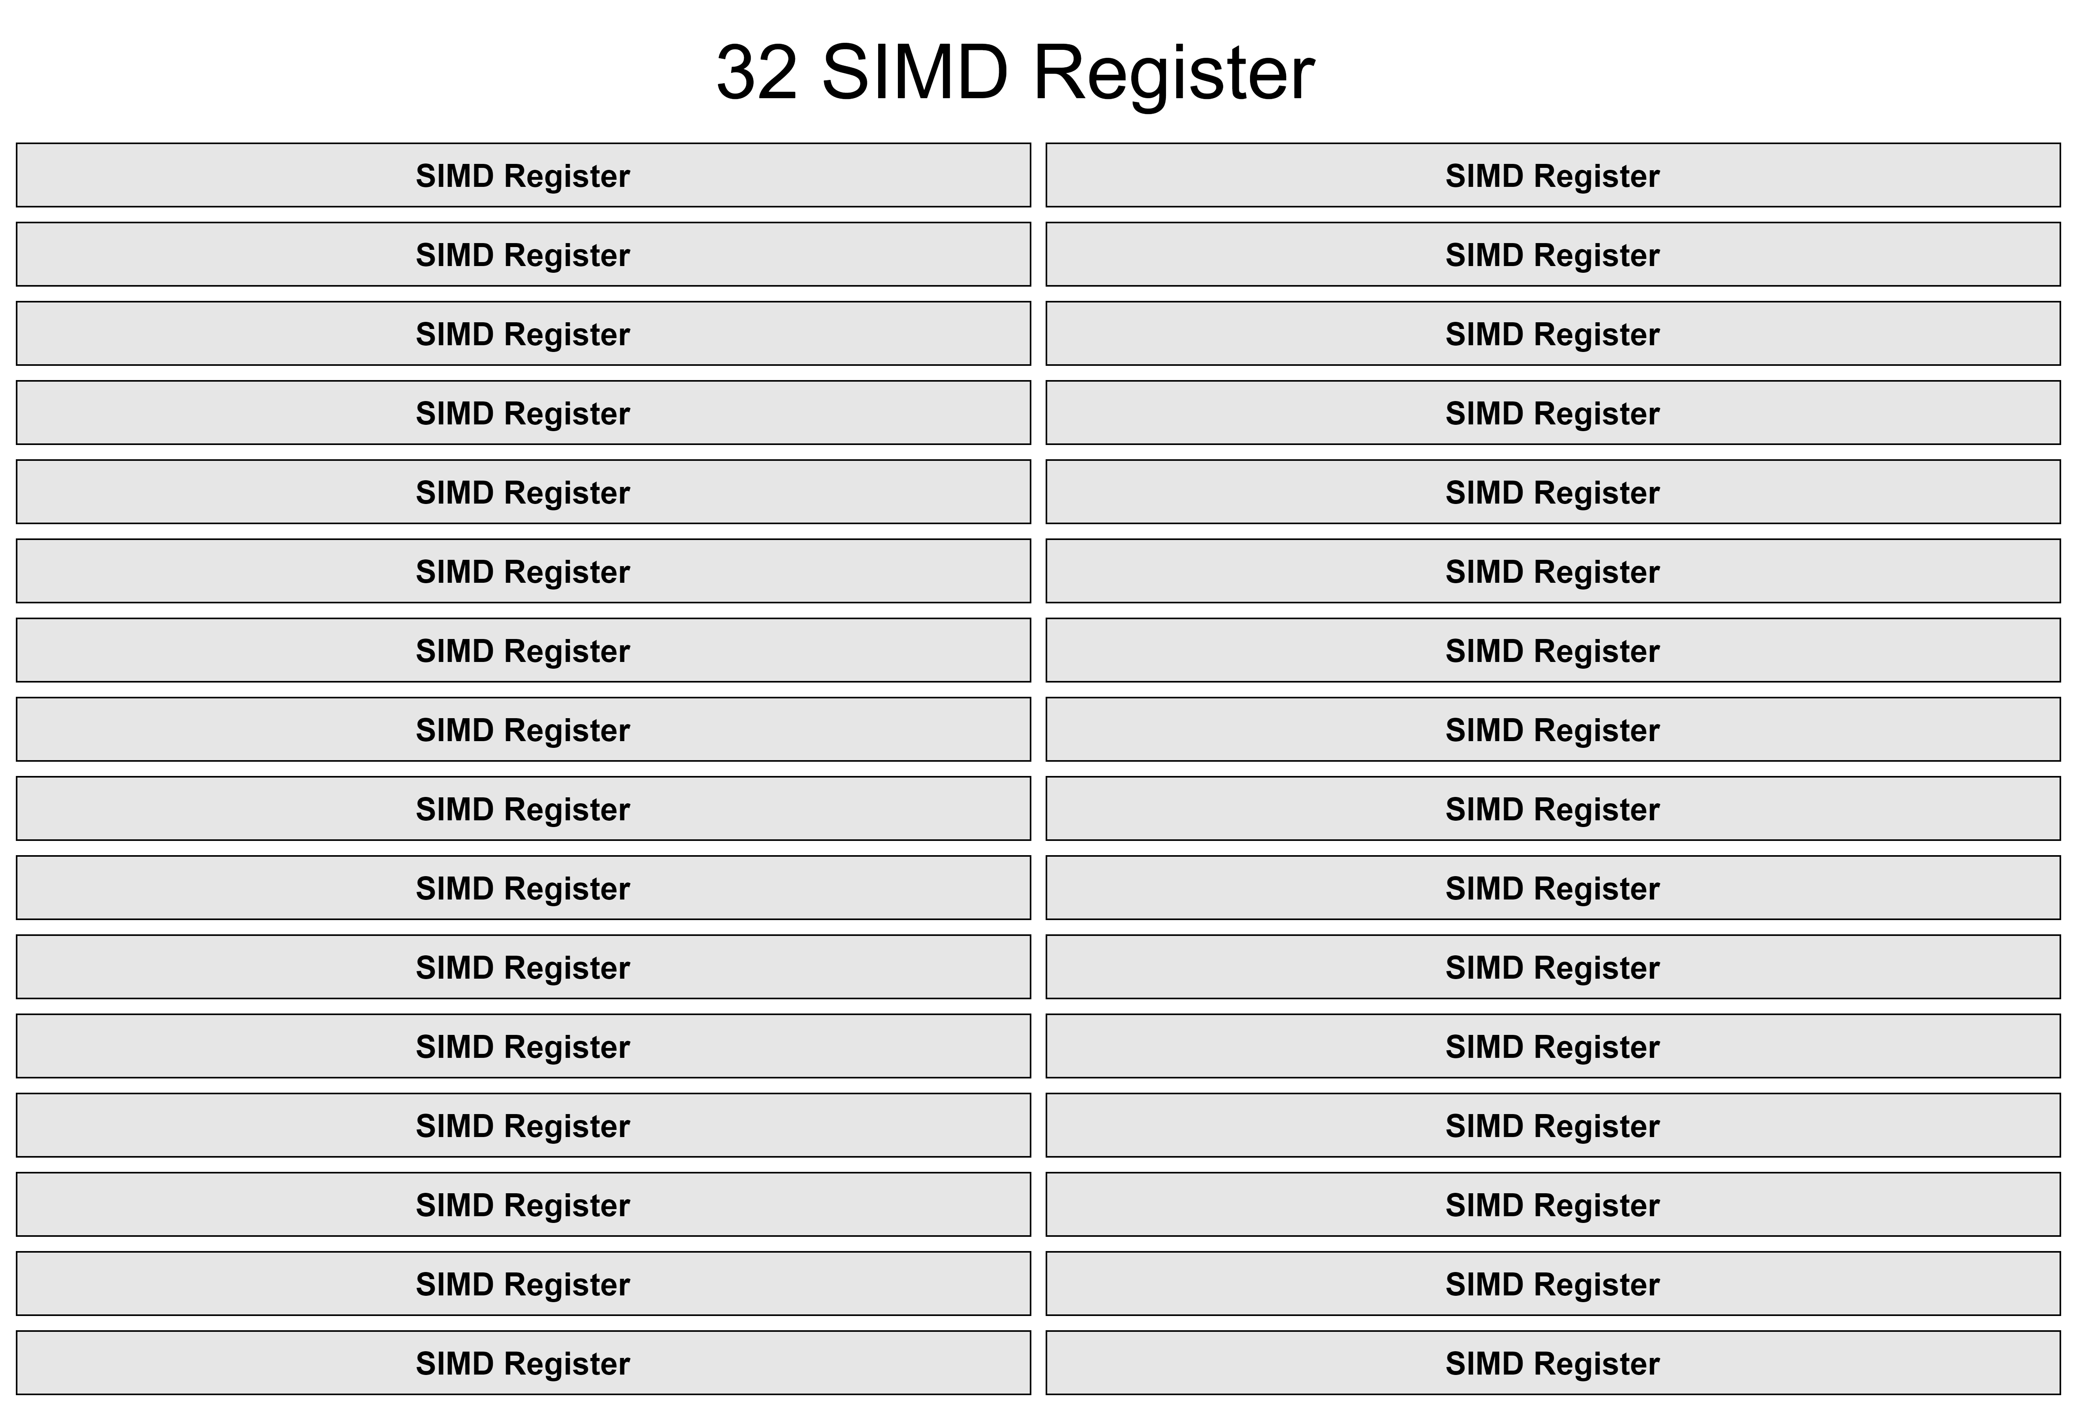

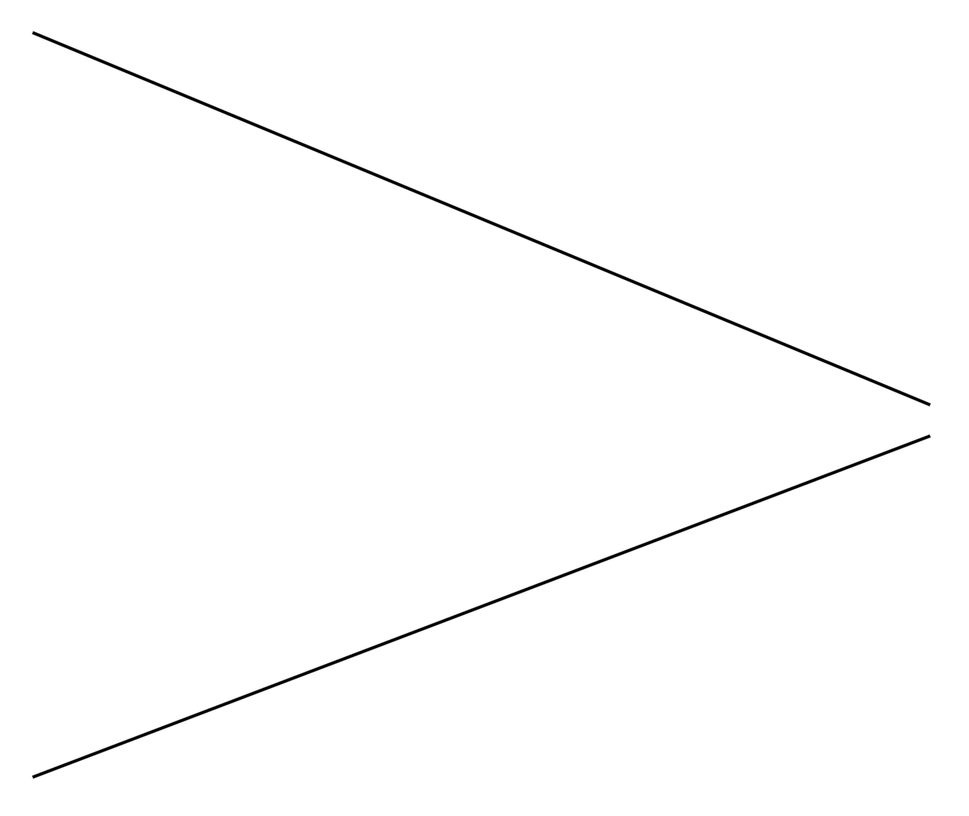
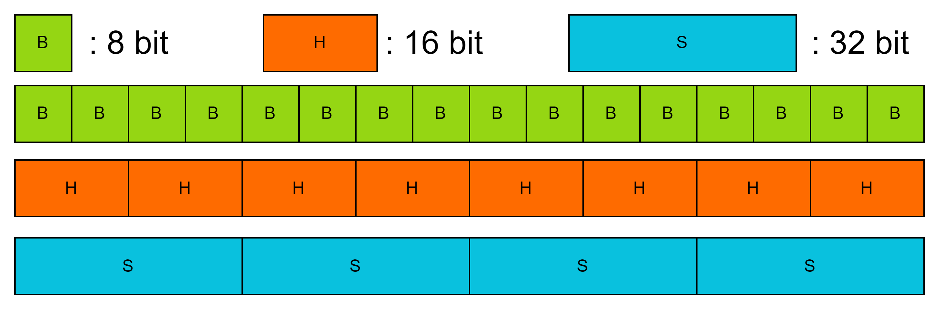
Semi-Final Stage – Software Optimization
ARM SIMD Register
128-bit length ARM SIMD Register
ARM CPU’s 32 SIMD Registers
The ARM CPU has 32 SIMD Registers with a 128-bit length.
Using ARM SIMD Register, maximize parallelization of matrix multiply operation.
The minimum processing bit-precision is 8-bit.
Notes:
As a short background, this is the ARM simd register structure, which has a 32 simd register and each of the registers has a one hundred twenty eight bit length.
to accelerate the multiply matrix operation, we should have to maximize this simd parallelization.
and the minimum processing bit-precision is 8-bit.

Slide 19
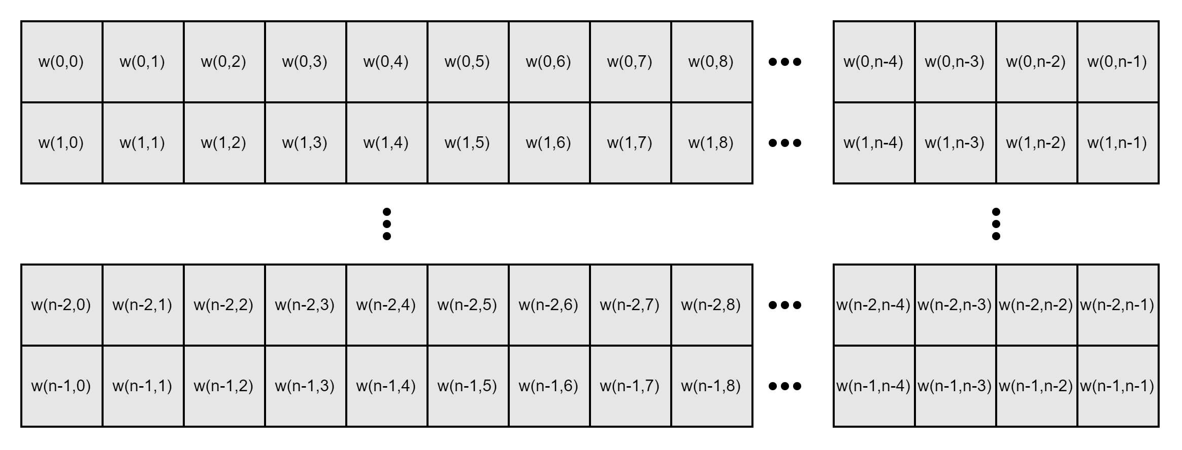
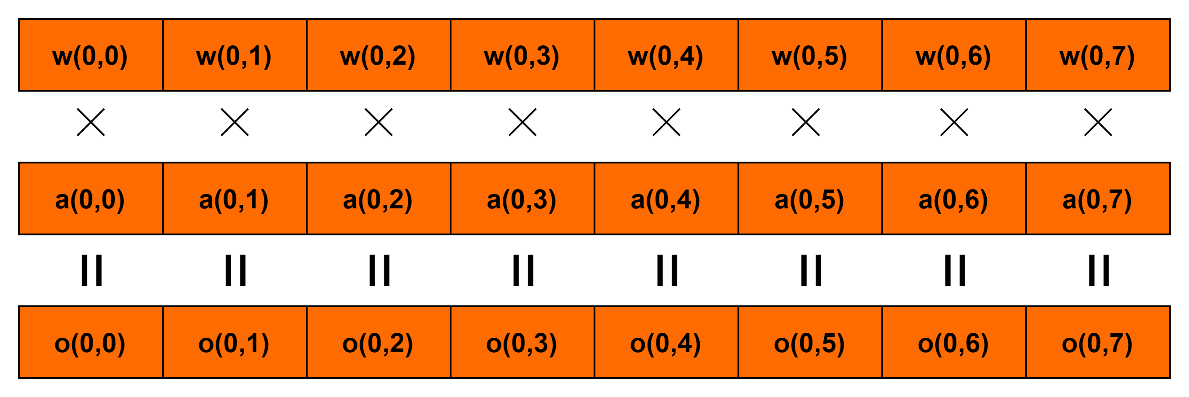
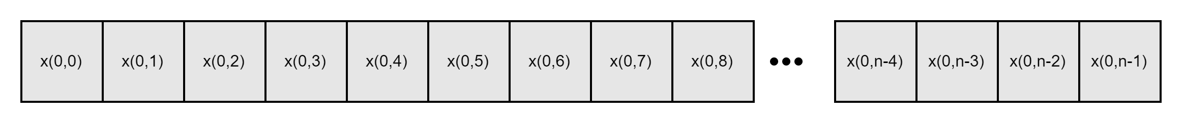
Semi-Final Stage – Software Optimization
Example) FP 16 SIMD Matrix Multiply (W16A16)
vfmaq_f16(w, x, o)
vld1q_f16(w)
vld1q_f16(x)
Weight (FP16)
Fused Multiply Add (FP16)
Activation (FP16)
Using 3-register, 8 outputs are processed in 1 Loop.
Notes:
and to simply show you our technique, this is simple example of fp six teen matrix multiply operation.
it use vector load intrinsic of weight and activations, and using three registers, the 8 outputs are processed in one loop.

Slide 20
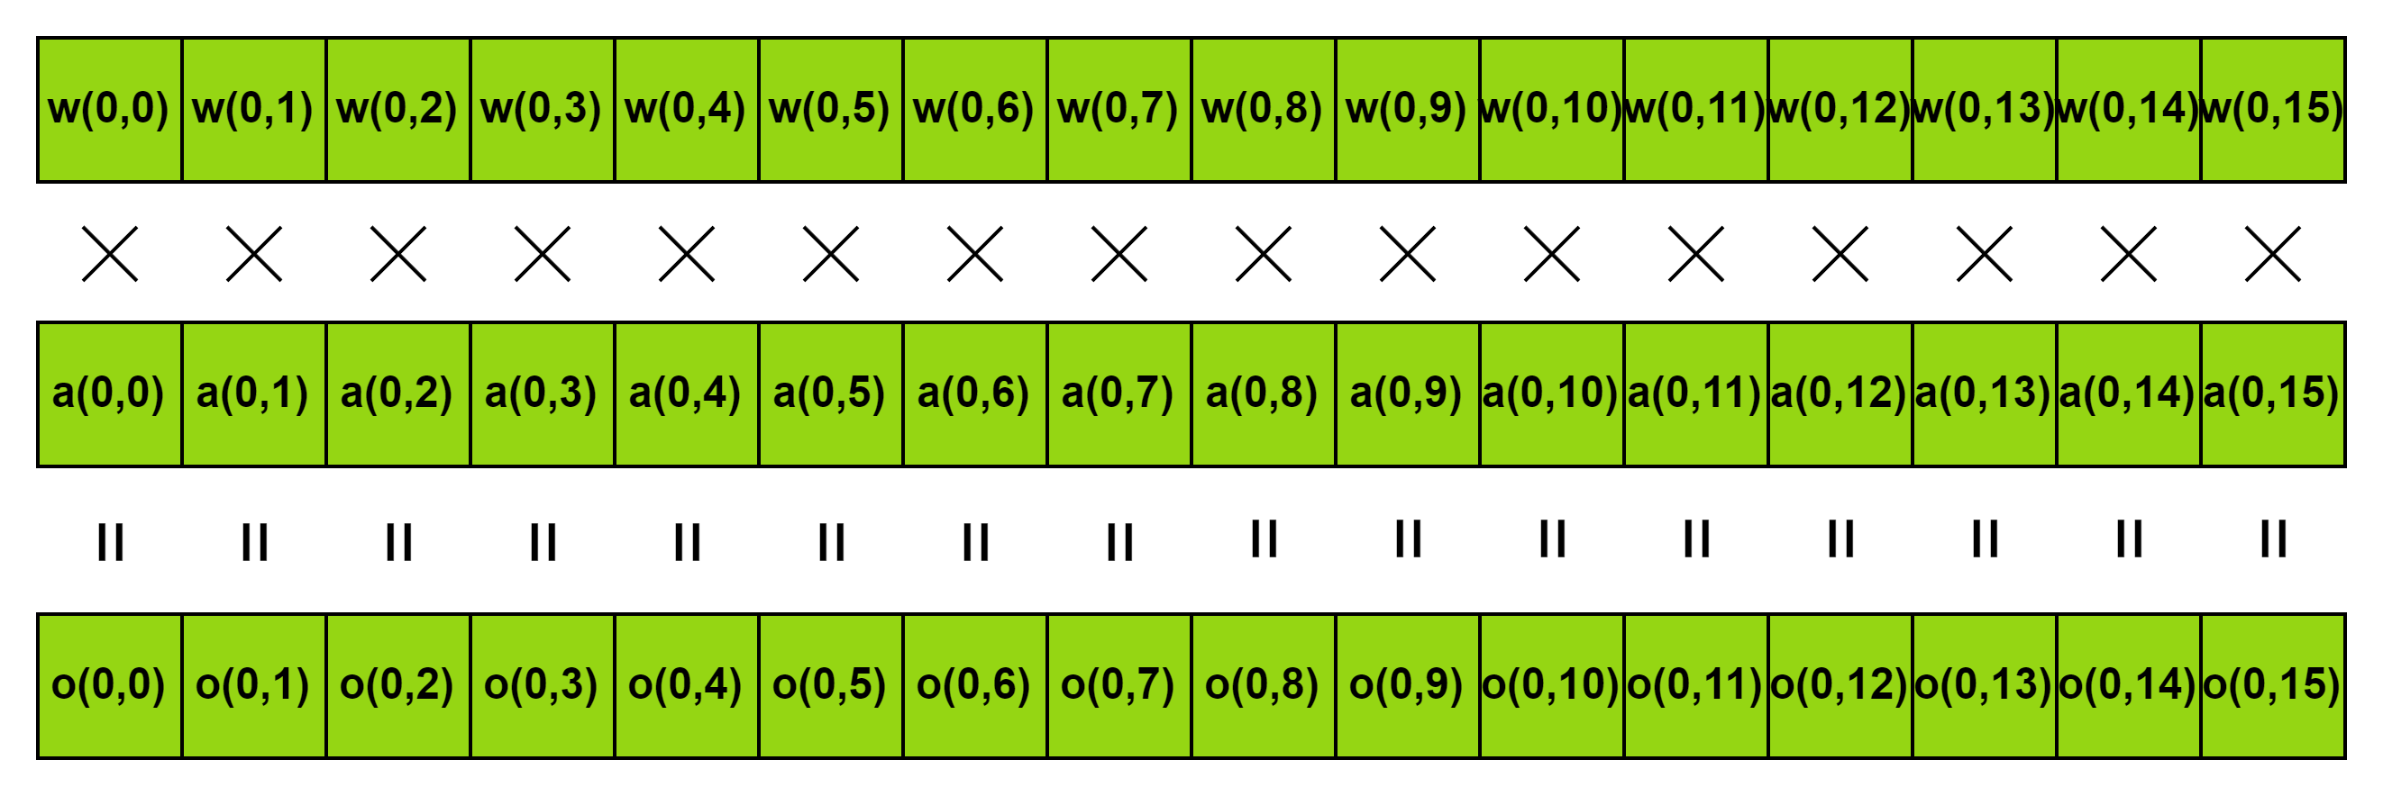
Semi-Final Stage – Software Optimization
Example) INT8 SIMD Matrix Multiply (W8A8)
vld1q_s8(w)
vdotq_s32(w, x, o)
vld1q_s8(x)
Weight (INT8)
Vector Dot-Product (INT8)
* scale
Activation (INT8)
*
Acc (FP 32)
Using 3-register, 16 outputs are processed in 1 Loop.
Notes:
and second example which is eight bit matrix multiply operation, it also load vector of integer eight bit, then it can load twice more elements than fp six teen. and then execute vector dot-product and the output is sclaed to fp thirty two format and then move to accumulator. so, by using three registers six teen outputs are processed in one loop.

Slide 21
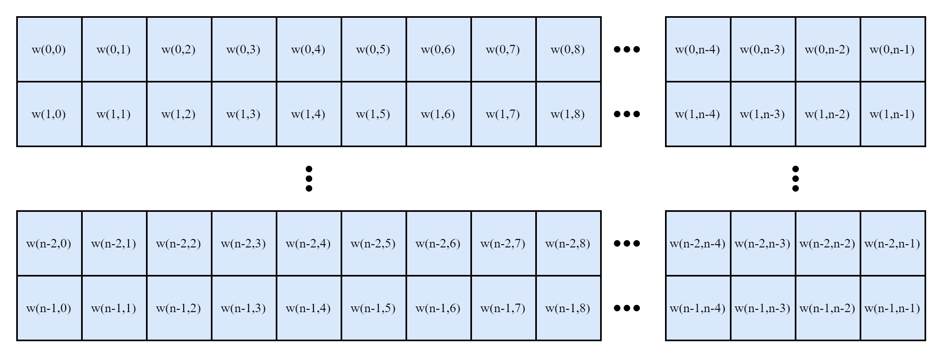
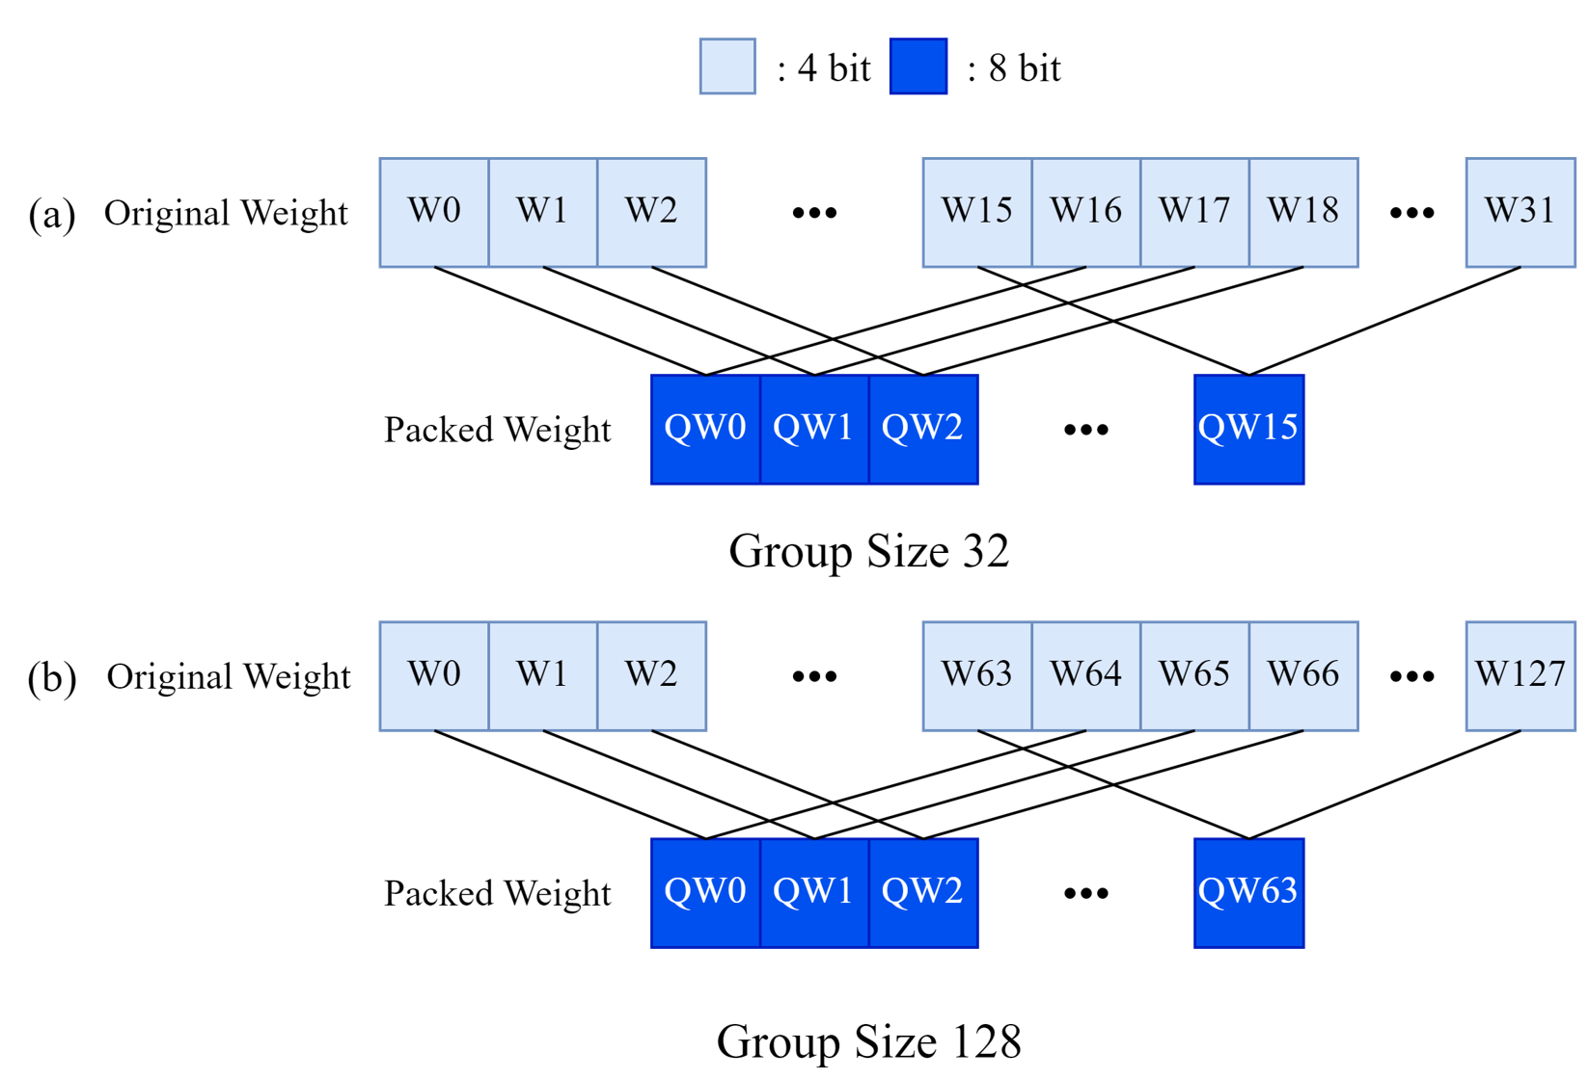
Semi-Final Stage – Software Optimization
Methodology) INT4 SIMD Matrix Multiply – Step 1 – Packing Weight
Weight (INT4)
Packing 4-bit data into 8-bit data type
Activation (INT8)
Minimum processing unit of SIMD Register is 8-bit.
So, we pack the INT4 weight into INT8 data type.
Notes:
this is our main methodology. we utilize integer 4bit and activation of 8bit matrix multiply kernel. and as i said earlier, the minimum processing unit of simd register is 8 bit. so we pack the 4 bit weight into 8 bit data format as you can see in the right figure which is example of thirty two group size.

Slide 22
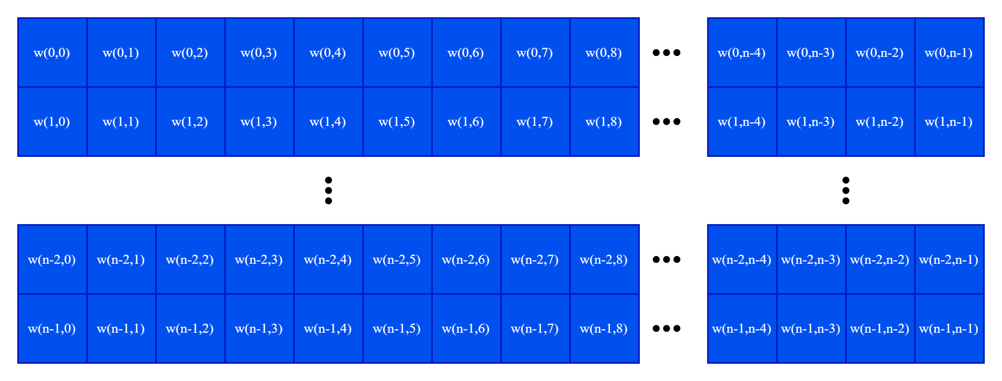
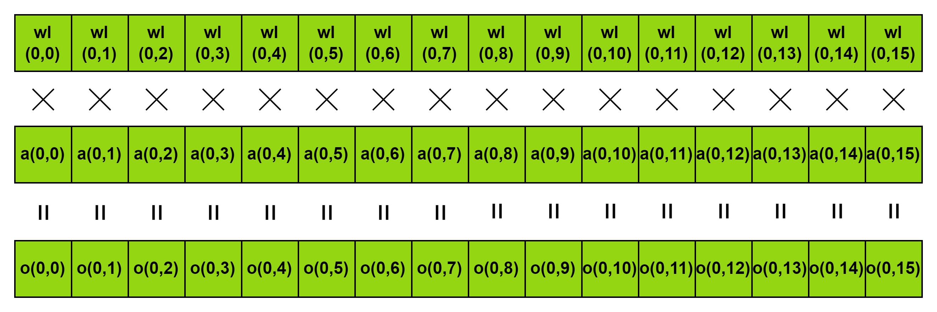
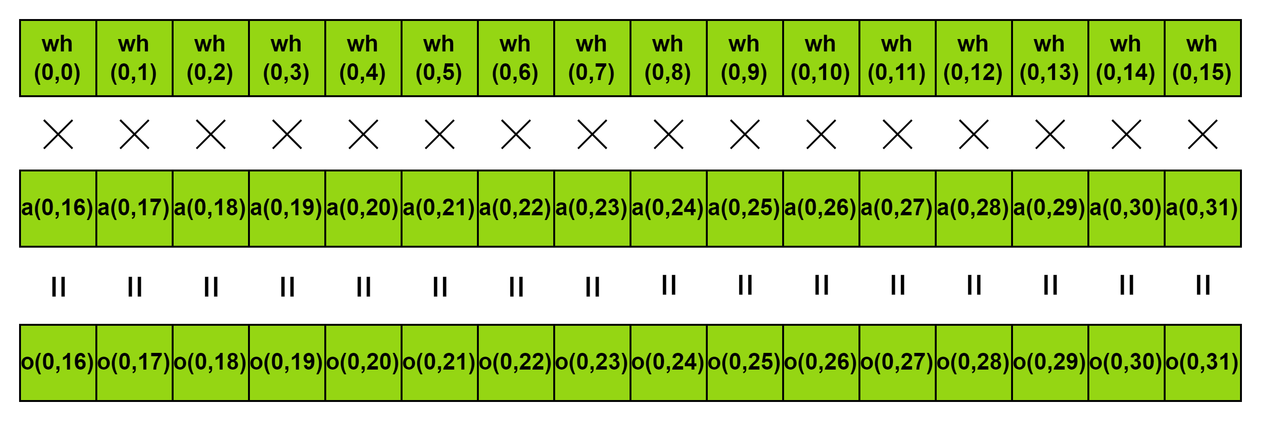
Semi-Final Stage – Software Optimization
Methodology) INT4 SIMD Matrix Multiply – Step 2 – Unpack & Multiply (W4A8)
Process Low 4-bit
Weight (INT4)
Activation (INT8)
Process High 4-bit
Unpack 8-bit weight into 4-bit.
Low memory consumption, requires twice less vector load than INT8.
Notes:
and after the packing, execute unpack and multiply operation. unpack the 8 bit weight into four bit and process each of low 4bit and high 4bit. since the mimimum processing unit of simd register is 8bit, the thorughtput of the each register is same with eight bit matrix multiply. but because it has 4-bit data type, it has low memory consumption and requires twice less vector load than int8 when it load the weight vector.

Slide 23
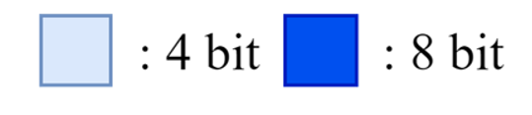
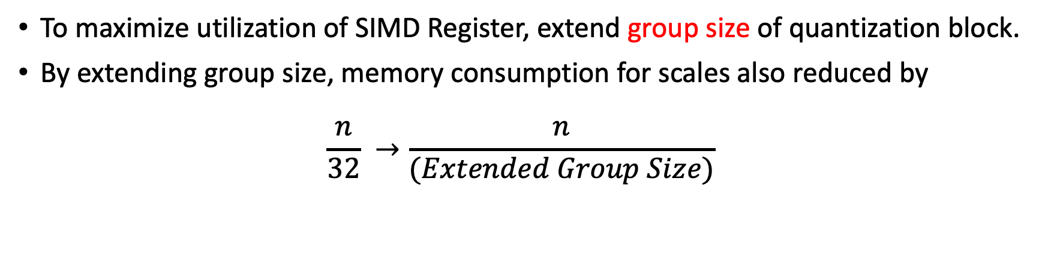
Semi-Final Stage – Software Optimization
Extend Group Size
To maximize utilization of SIMD Register, extend group size of quantization block.
By extending group size, memory consumption for scales also reduced by $\frac{n}{32} →\frac{n}{(Extended Group Size)}$
* n: number of elements
Packing Scheme (Group Size 32) (default)
Packing Scheme (Group Size 128) (Extended)
Notes:
and then, to maximally optimize the model size, we extend group size of qwen model. there's some benefit by extending the group size of quantization block, first, it can maximally utilze simd register by operate as many registers as possible in a one loop. and by extending group size, the memory consumption for scales also reduced by the extended group size. Although this might be minor optimization, it is important to achieve even a small advantage in small models.

Slide 24
Semi-Final Stage – Results
Optimization Results
 | max_rss (MB) | max_vss (MB) | Prefill (tokens/s) | Decode (tokens/s)
Baseline Score | 10565.88 | 11923.00 | 87.41 | 2.44
FP16 | 4696.93 | 4773.96 | 87.84 | 27.76
INT8, G = 32 | 2201.95 | 2538.53 | 76.95 | 42.47
INT8, G = 64 | 2150.08 | 2483.8 | 92.67 | 46.26
INT8, G = 128 | 2119.6 | 2456.43 | 103.74 | 46.95
INT4, G = 32 | 1402.59 | 1739.29 | 70.74 | 43.38
INT4, G = 64 | 1274.59 | 1612.60 | 79.89 | 46.91
INT4, G = 128 | 1245.25 | 1585.23 | 92.74 | 47.27
Considering all aspects of optimizations, we use INT4, Group Size = 128 case.
Notes:
this is software optimization result. as you can see, when we use 4bit weight and with one hundred twenty eight group size, we reduced nine times less than original model in the memory consumption and accelerate a little bit in prefill stage, and greatly accelerate the decode throughput

Slide 25
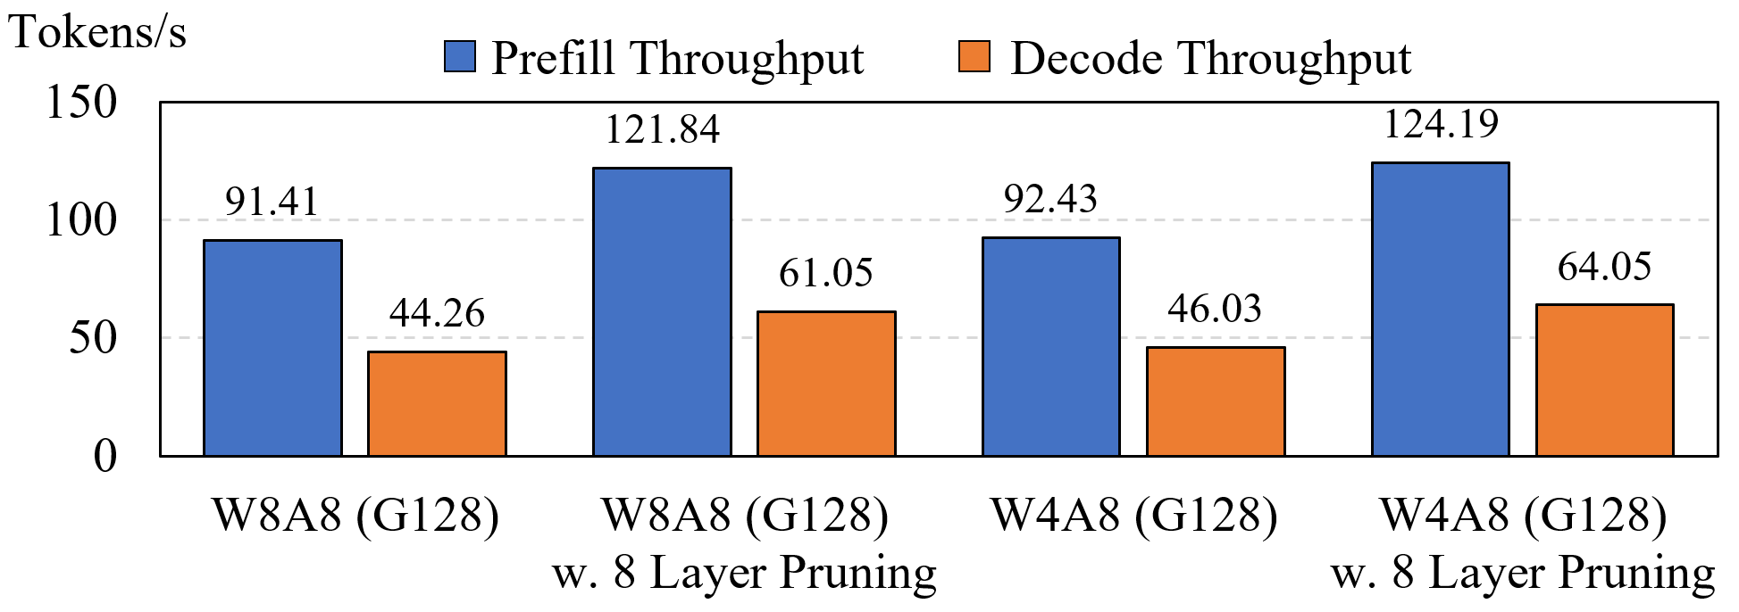
Semi-Final Stage – Results
Optimization Results
We’ve decided our best case as W4A8 (G 128) with 8 layer pruned
PIQA Accuracy: 0.73 → 0.71 (x 0.97)
Prefill(tokens/s): 87.41 → 124.19 (x 1.42)
Decode(tokens/s): 2.44 → 64.05 (x 26.25)
Max_RSS(MB): 10565 → 983.76 (x 0.09)
Max_VMS(MB): 11923 → 1321.83 (x 0.11)
Notes:
and the final optimization result. with the algorithm and software optimization we have decided our best case as weight four bit and activation eight bit with one hundred twenty eight group size and eight layer pruned. in this case, the throughput and memory consumption was greatly improved at the expense of a slight decrease in accuracy.

Slide 26
Thank you.
Notes:
thanks for hearing my presentation. and if you have any question about the presentation feel free to ask.

